Slide 1
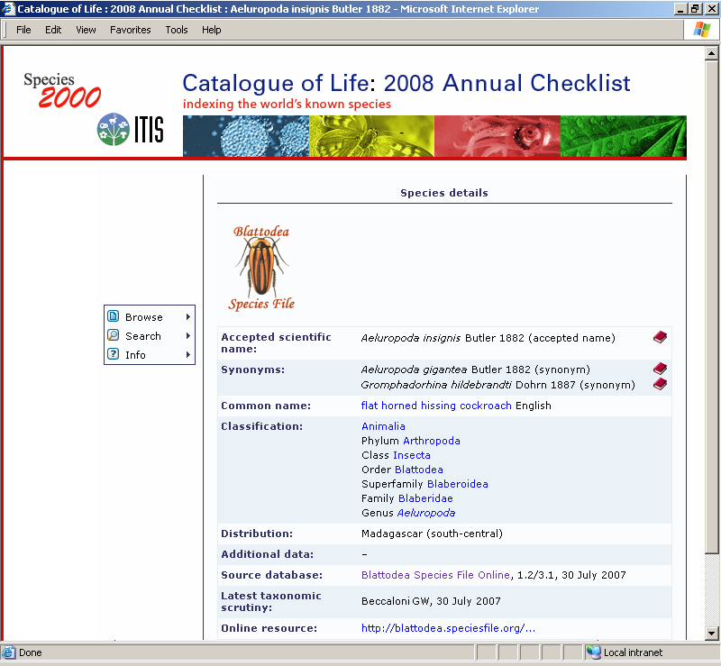
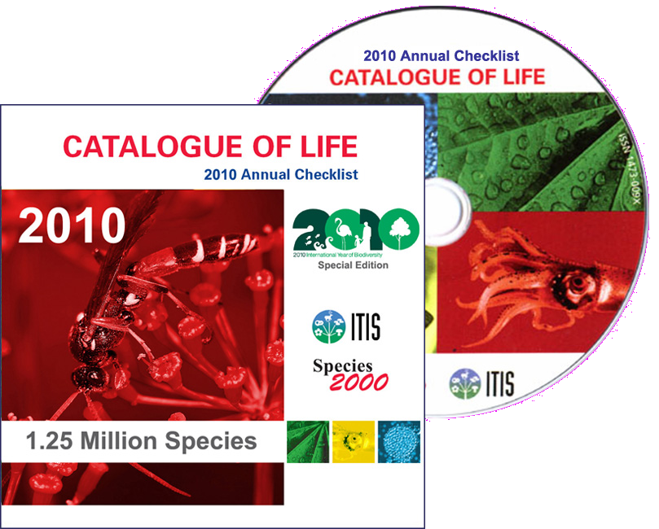
The pre-existing Catalogue of Life
www.catalogueoflife.org
Currently:
1,257,735 species
animals
plants
fungi
microorganisms
2010 Annual Checklist

